Slide 1



RNS Institute of technology
Department of Information Science and Engineering
Presentation on,
Web Technologies mini project titled,
FUND INVESTMENT COMPANY WEBSITE
Under the guidance of,
Mrs. Sowmya S K
Assistant Professor,
Dept of ISE.
By,
TILAKRAJ S.RAO (1RN17IS109)
SMRUTHY V (1RN17IS119)

Slide 2

agenda
Introduction
Objectives
Frontend
Backend
Functionalities
Hardware and Software Requirements
Pseudocode
Snapshots
Conclusion and future Enhancements
This Photo by Unknown Author is licensed under CC BY-SA

Slide 3
introduction
Investment company is a company (corporation, business trust, partnership, or limited liability company) that issues securities and is primarily engaged in the business of investing in securities.
It's a platform where companies and startups can share there innovative ideas to get the funds for their companies.
It invests the money it receives from investors on a collective basis, and each investor shares in the profits and losses in proportion to the investor's interest in the investment company.
An investment fund provides a broader selection of investment opportunities, greater management expertise, and lower investment fees that investors might be able to obtain on their own. Types of investment funds include mutual funds, exchange-traded funds, money market funds, and hedge funds.

Slide 4
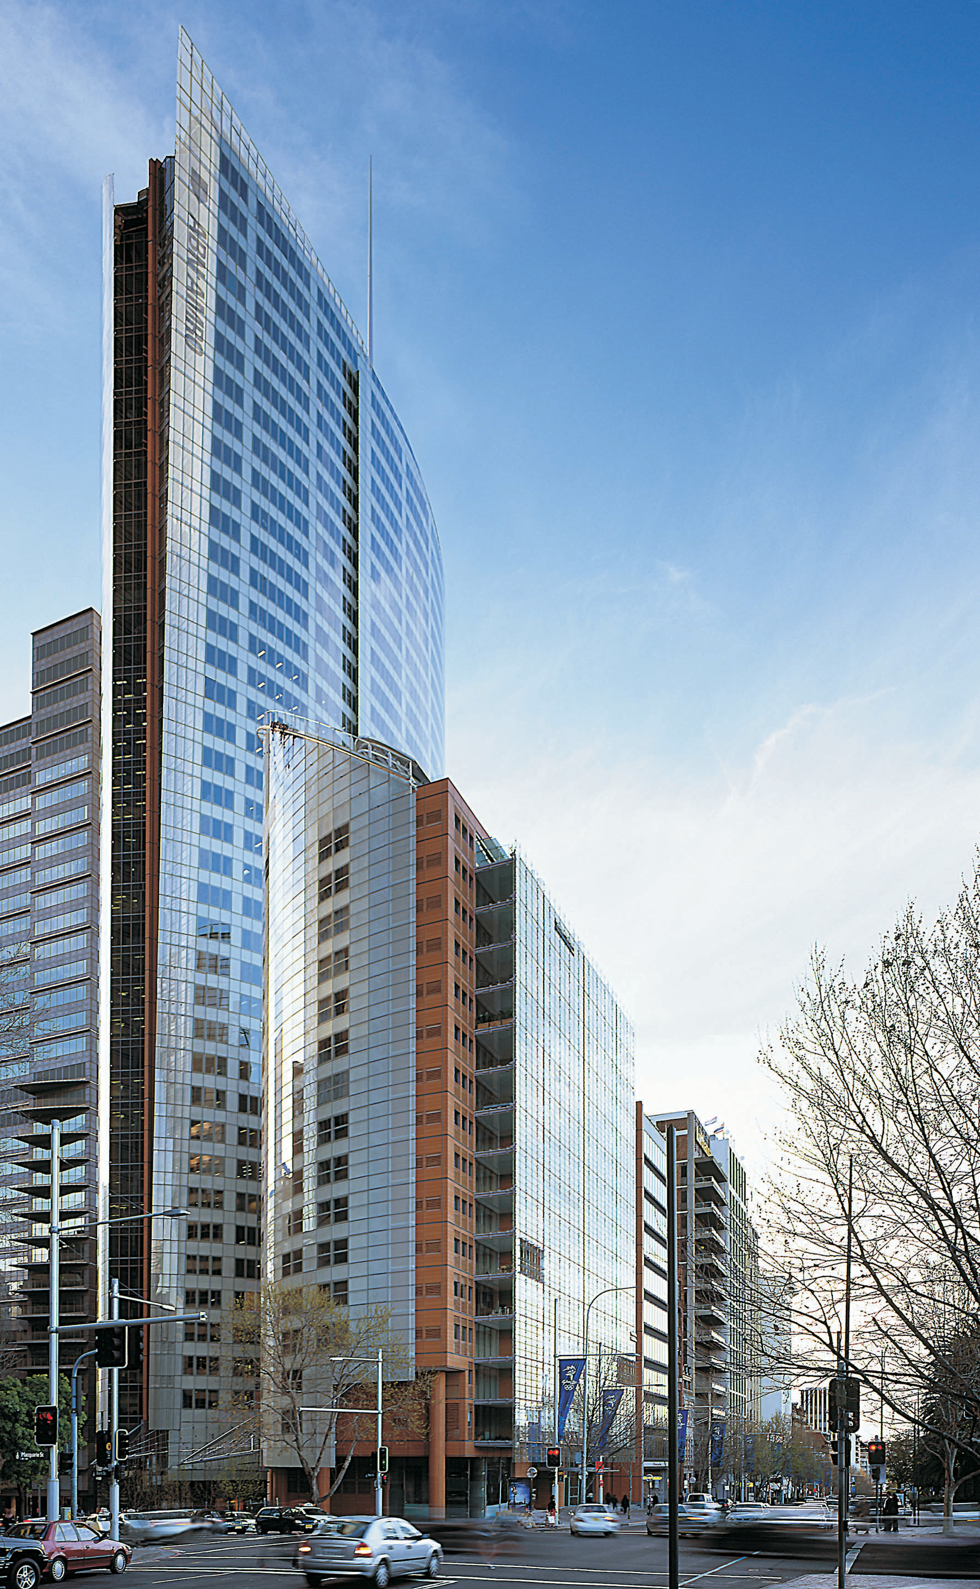
Objectives of the project
Providing an online platform where companies and startups can share there innovative ideas to get the funds for their companies.
To reduce the manual work in maintaining and updating the Investment details.
Increasing the efficiency of profit, loss record management using some algorithms.
Decrease the time required to contact and share the project details, ideas , objectives of respective company to the investors .
To make the system more secure by creating different portals for different type of selector(education , IT sector , Healthcare , industrials ,finance etc) for different companies

Slide 5
FRONTEND
Frontend plays a major part in our project, this visualizes the way website looks, frontend development includes designing the web page using HTML, CSS ,Bootstrap.
Frontend has always been an important factor in making people get interested in the content that is to be displayed in the website. This provides a graphical interface to the user.
There are multiple front end technologies present in the industry right now but the basic foundation always start from HTML,
The Frontend technologies used to accomplish our project are :
- HTML
- CSS
- BOOTSTRAP

Slide 6
FRONTEND
HTML stands for Hypertext markup language provides a standard markup language for documents that have to be displayed on the browser. HTML can be assisted by CSS, JS for helping in design formats.
CSS (Cascading Style Sheets), this helps for designing the basic HTML pages, this can be in the form of background styling, content styling , spacing and also using hover effects and many more.CSS can be used by using classes or Id’s within the html page.
Bootstrap is a free and open-source CSS framework directed at responsive, mobile-first front-end web development. It contains CSS- and JavaScript-based design templates for typography, forms, buttons, navigation and other interface components

Slide 7
BACKEND
We have used backend as PHP AND JAVASCRIPT as the main components. This always helps to easily store the data in the backend and retrieve it in whenever necessary, backend technology.
(Hypertext Preprocessor) is a widely-used open source general-purpose scripting language that is especially suited for web development and can be embedded into HTML.

Slide 8
HARDWARE AND SOFTWARE REQUIREMENTS
SOFTWARE REQUIREMENTS:
HARDWARE REQUIREMENTS:
64 / 32 BIT CPU
I5 / I3 PROCESSOR
3 / 2 GB RAM
500 GB MEMORY
OPERATING SYSTEM(Windows 10)
PHP
HTML5
CSS3
JAVASCRIPT
BROWSER

Slide 9
FUNCTIONALITIES
Functional Requirements defines the internal working of the software, i.e.. the calculations, technical details, data manipulation and processing and other specific functionality.
The following are the Functionalities :
Companies can reach us using this platform.
Companies can share their ideas .
Can get investment strategies / advice .
Provides a platform to the companies which
are having a large vision about where they
want their companies to go.
5 . Companies can get investment within 24 hours after first meeting of their business explanation.

Slide 10
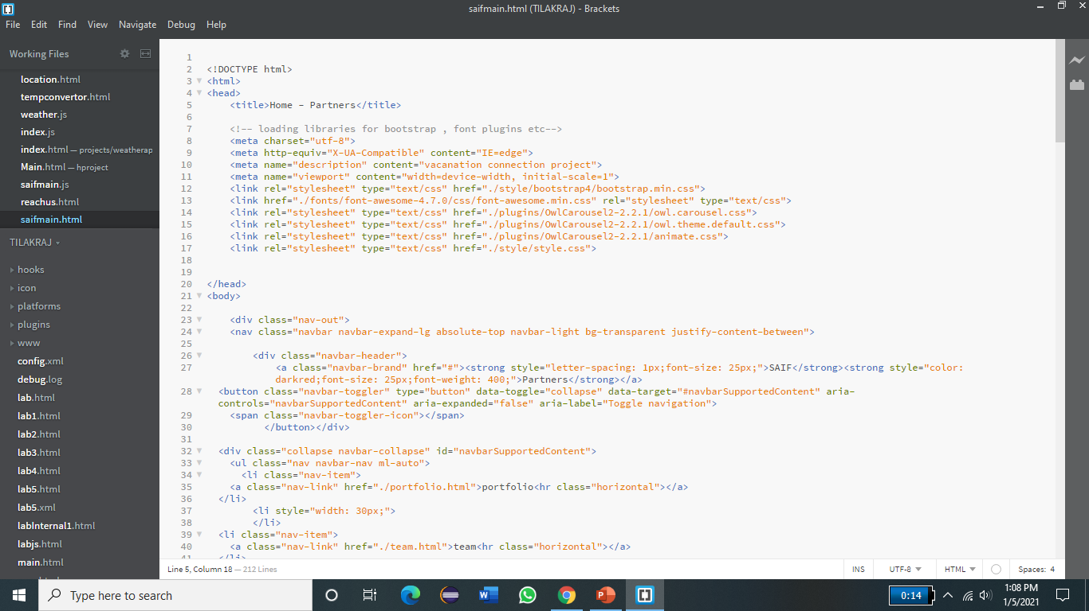
pseudocode

Slide 11
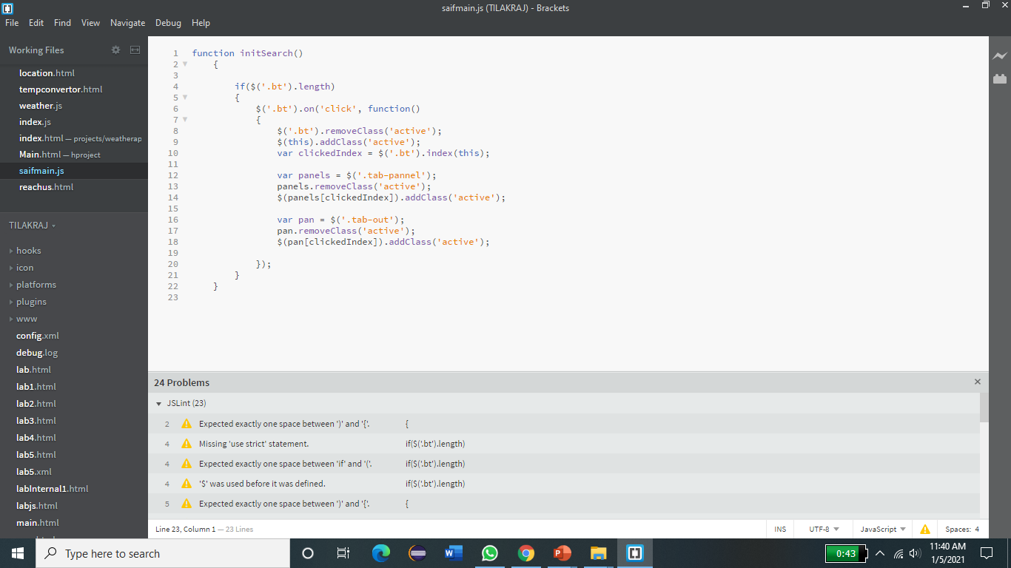
InitSearch() :

Slide 12
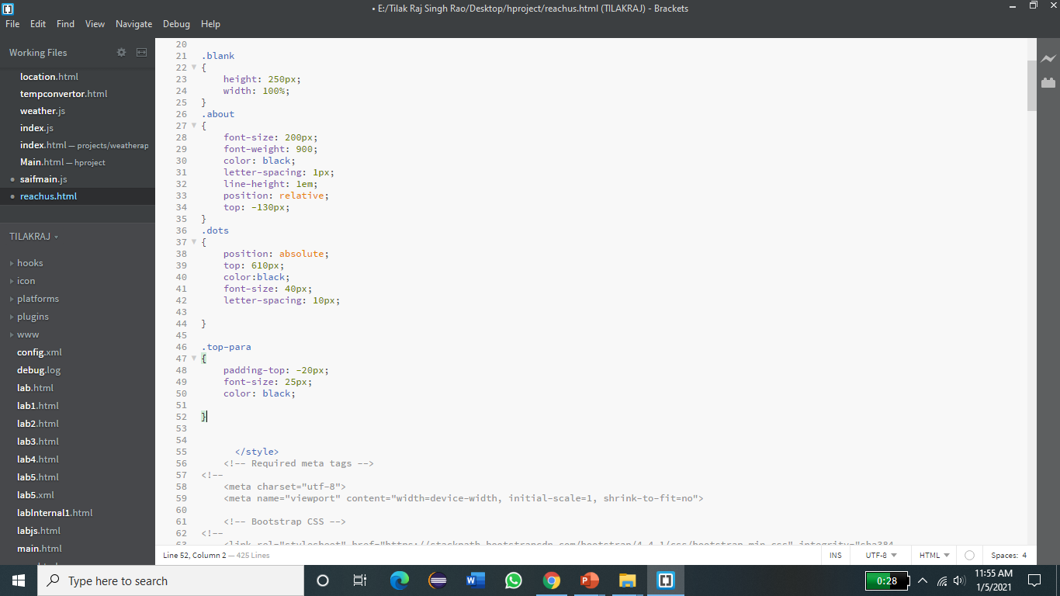
CSS

Slide 13
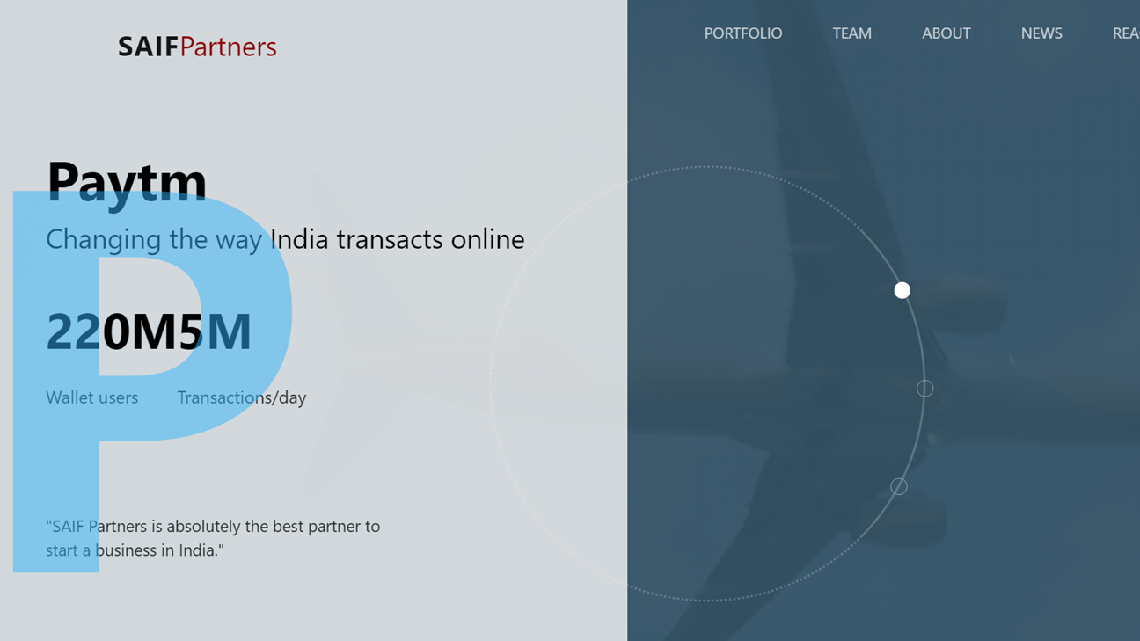
snapshots
SNAPSHOTS

Slide 14
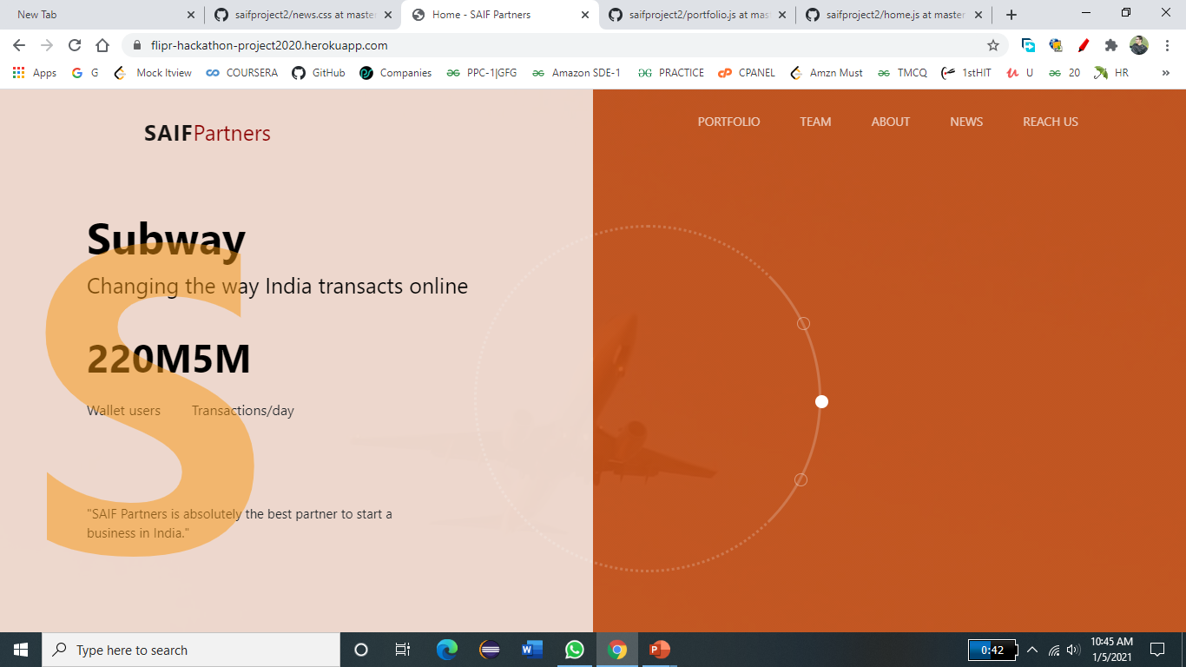
Home page

Slide 15

Portfolio Section:

Slide 16
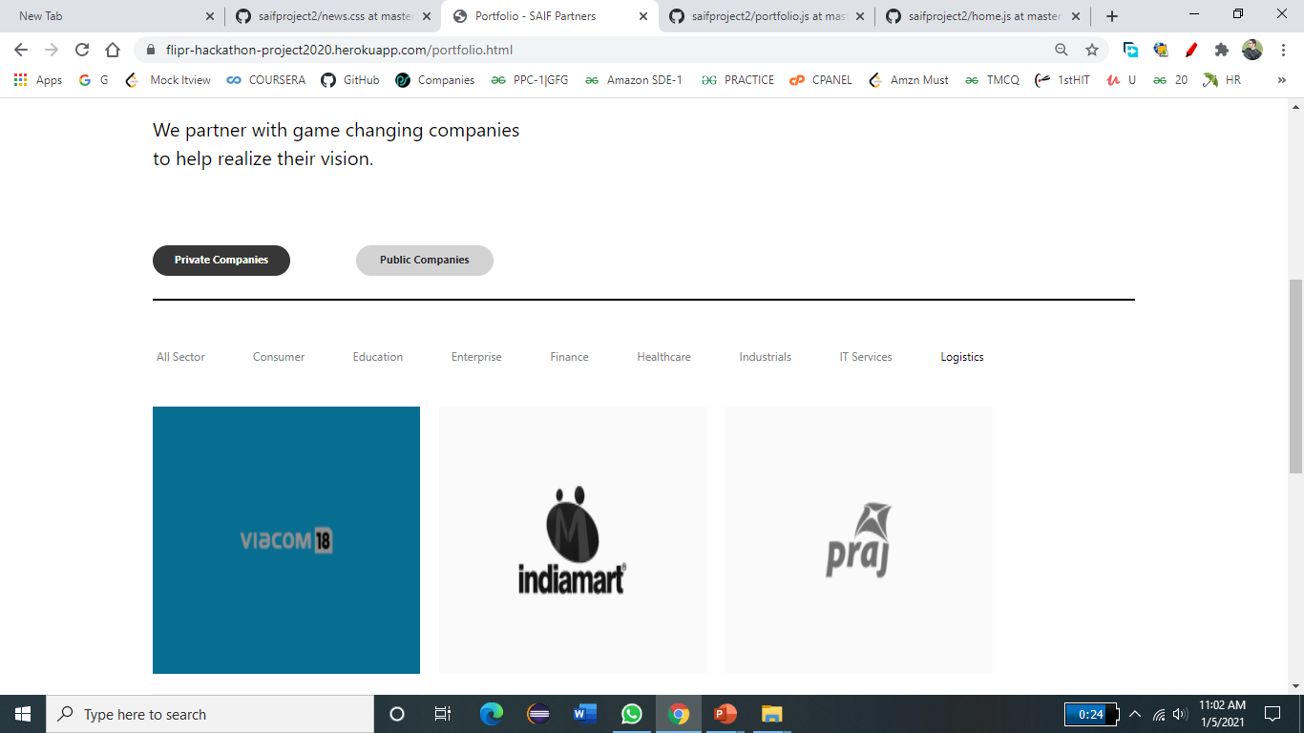

Slide 17
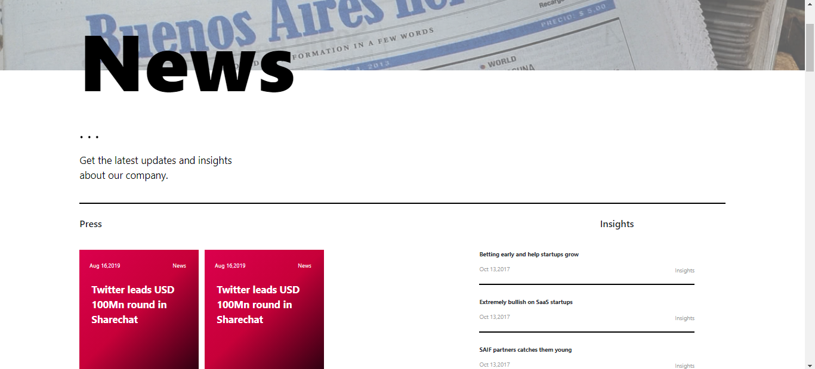
Notifications AND News :

Slide 18
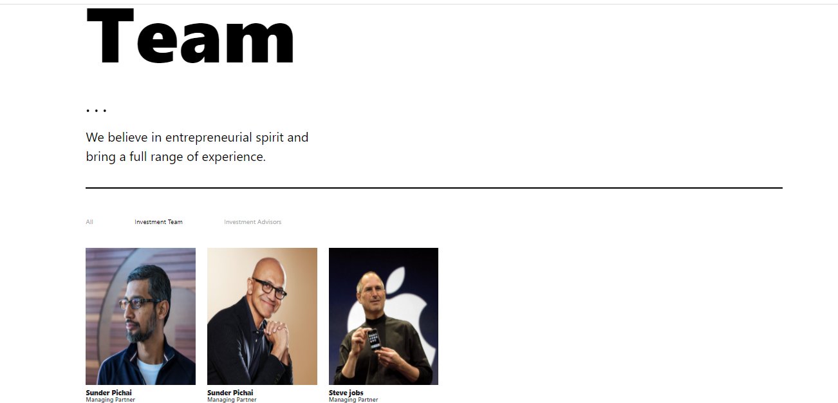
TEAM :

Slide 19
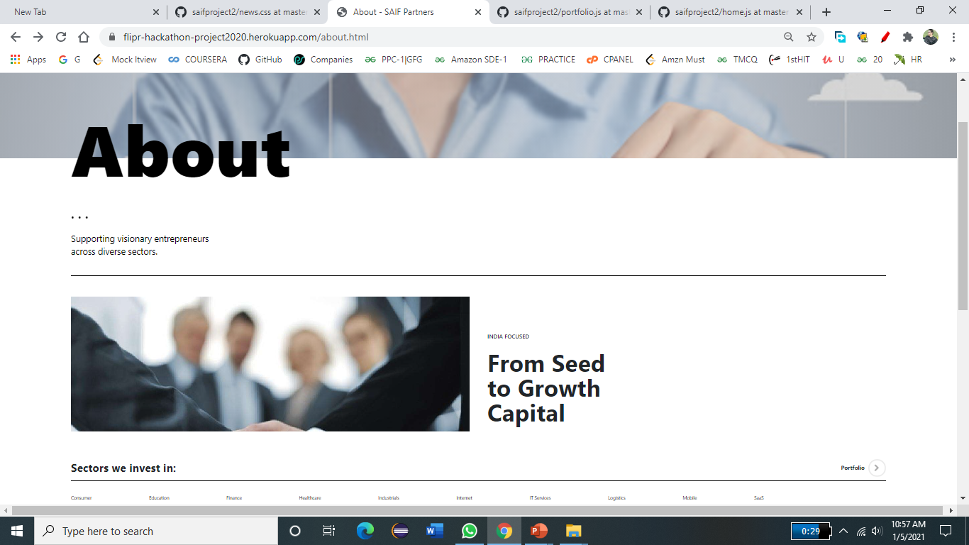

Slide 20
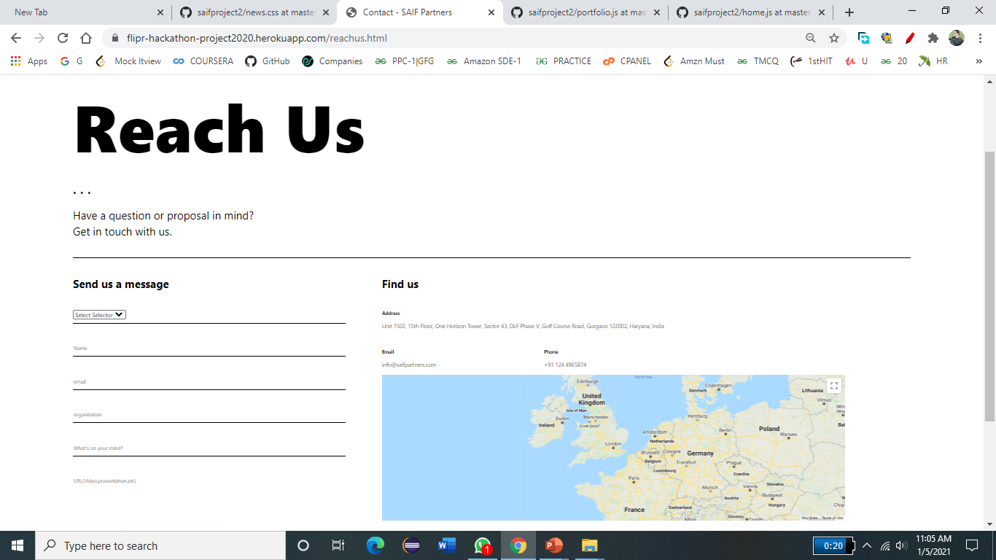
Reach Us:

Slide 21
Conclusions and future enhancements
Conclusions
Helps companies especially early-stage startups to develop their business both organically and corporately and with best management practices.
It assists in getting Investment advice .
It helps companies to grow from an early stage to a Big giant.
Future Enhancements
We can Use a Machine Learning Algorithms in backend to take decisions like whether to invest in a particular company or not on the basis of its market shares and its profits and losses in previous years .
Use of Dropbox for the documentation to upload online .
Use a checker which results in selection of good companies with better innovative ideas.

Slide 22
THANK YOU

